Slide 1
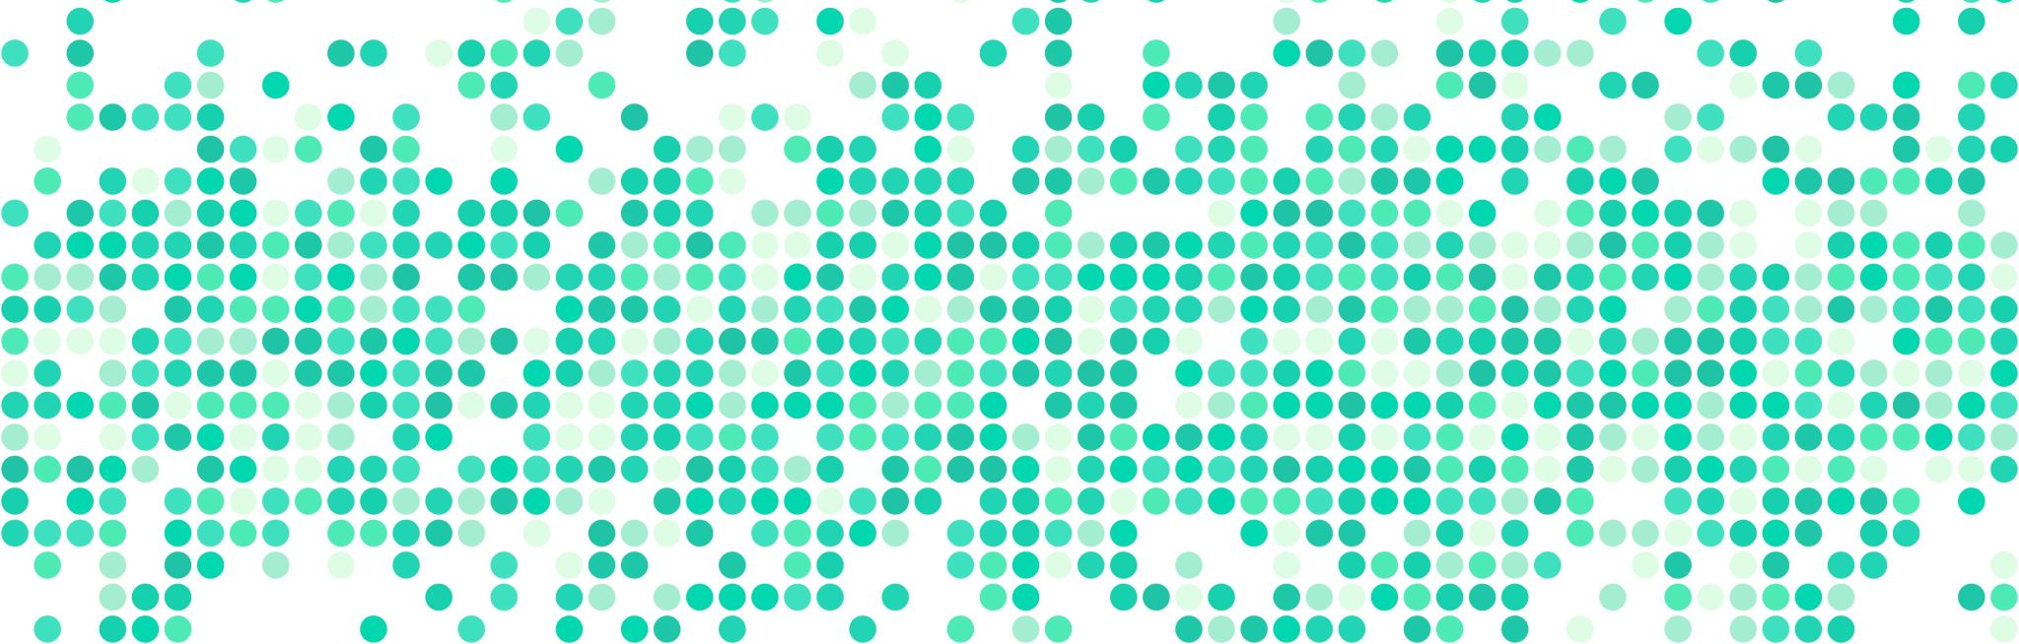
Crime and Inflation
Antonio Ortiz and Kurt Meyer

Slide 2
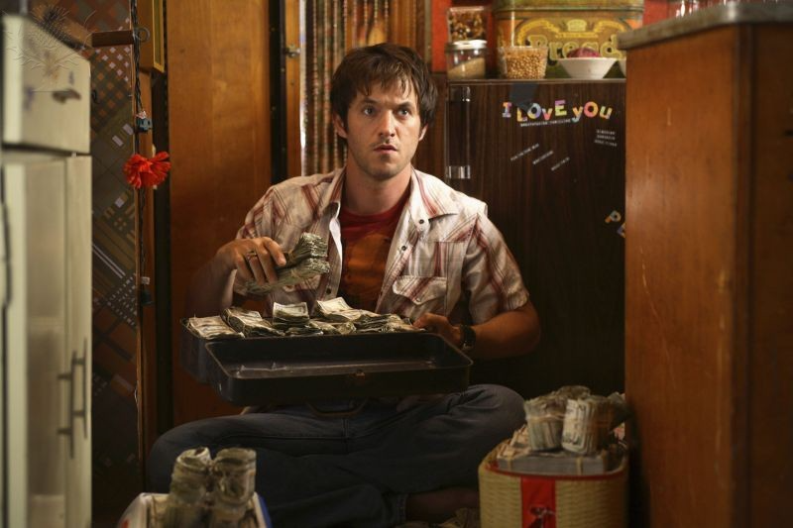

Research Question: Is there a relationship between rising inflation rates and crime?
Intuitively we expect money to be a major motivator when it comes to crime.
Academic research has been done over the years to answer this question.
However, we found nothing addressing recent inflation and crime concerns.
We do understand our analysis is rudimentary!
Notes:
Our research was based on the question of whether there is a relationship between the inflation rates and the amount of crime.
Our intuition tells us that, normally, money is a major motivator for crime.
Therefore, we might be biased, but we kept our research as focused as possible. But due to the nature of the data, the samples are limited, as not every country reports the statistics, and the countries that do, not all of them are completely trustable.
Therefore, our research will be completely focused on the US, as the US has extensive reports on crime.
But this will only make the research valid on the US, as crime is also tied to culture, local laws, among others.
So our research is not as extensive as we would like it to be.

Slide 3
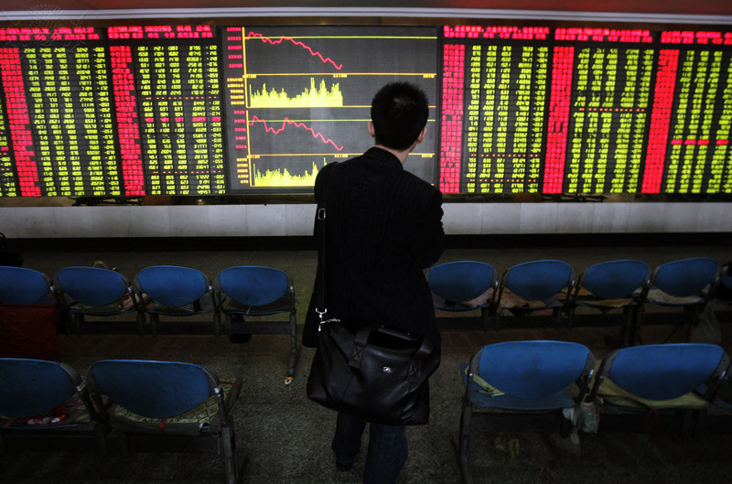
Datasets
We used two data sets.
Inflation data originated from the St. Louis Federal Reserve
Crime data came from the FBI Uniform Crime Reporting dataset and DisasterCenter
Notes:
We used two datasets: The St. Louis Federal Reserve for the inflation rates, and the FBI Uniform Crime Reporting dataset for the crime statistics.
However, the FBI dataset was split across every year, so we used DisasterCenter, which has the same data, but in a single dataset.

Slide 4
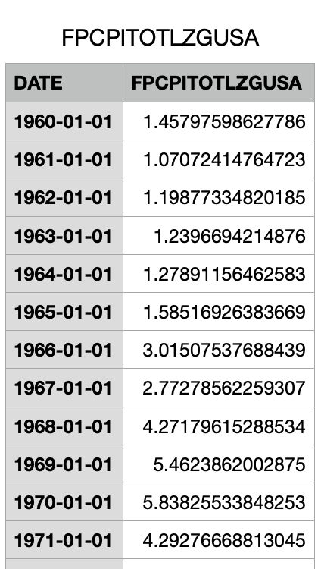
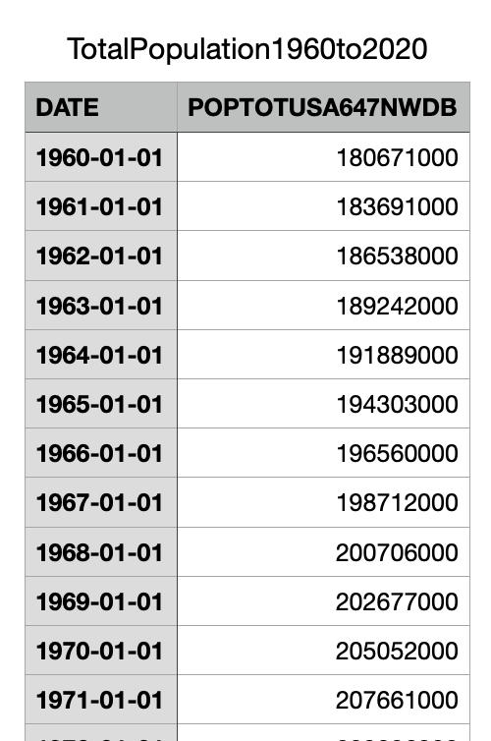
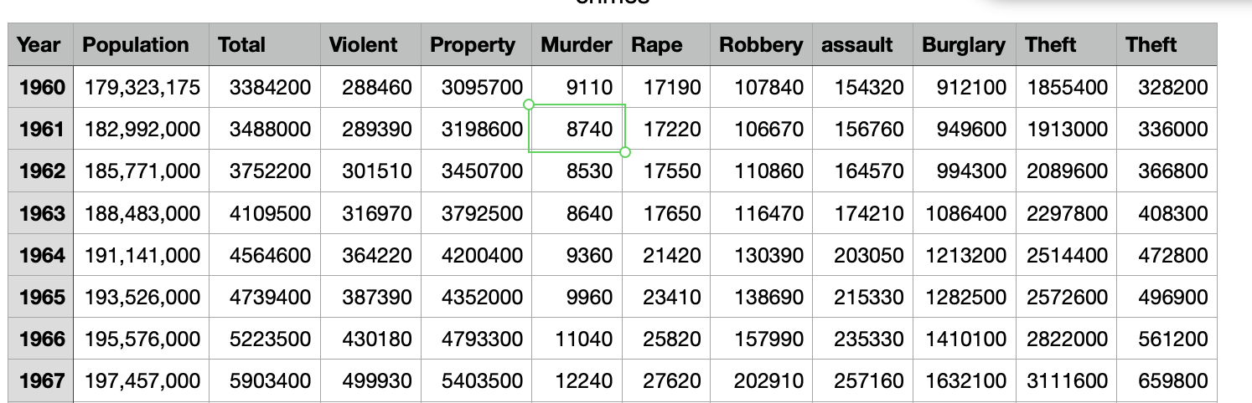
Data Preparation (Antonio)
Removal of outliers (only within 3 SDs)
Formatting dates
Converting crime data to per 100,000.
Notes:
Removal of outliers:
Removing outliers is a common practice, and the standard is that any data that is outside 3 standard deviations is considered an outlier. In this case, 5 out of 60 values were removed.
Formating dates:
The data had to be reformatted, as the date in the original dataset was a string, so it had to be reconverted to Date, and then to numeric so we could use it to filter by year easily.

Slide 5
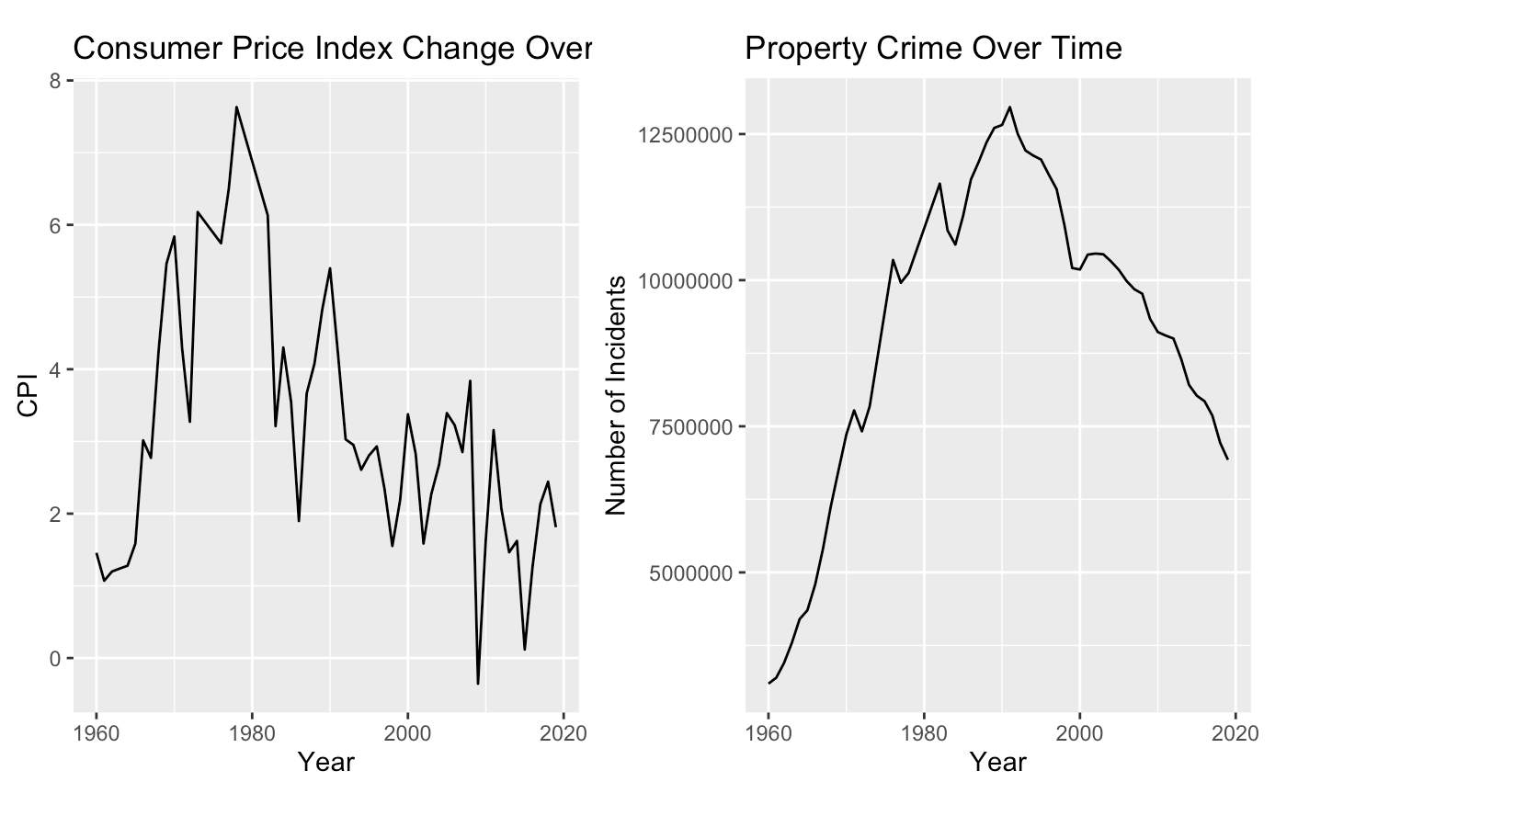
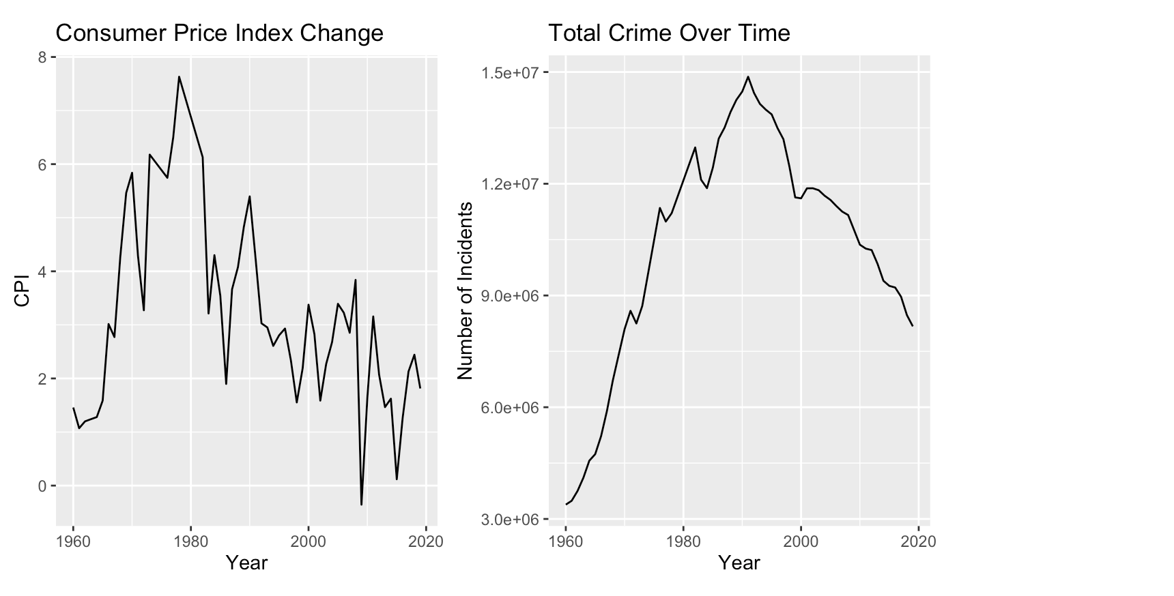
General Comparisons
Notes:
Some basic comparisons were made to see the behavior of different types of crimes next to the behavior of the CPI over the years.
Most of the graphics behaved very similarly, showing a stark increase following the increase in CPI, and then, a steady decrease, but with a delay. Their shape also resembles a normal distribution.

Slide 6
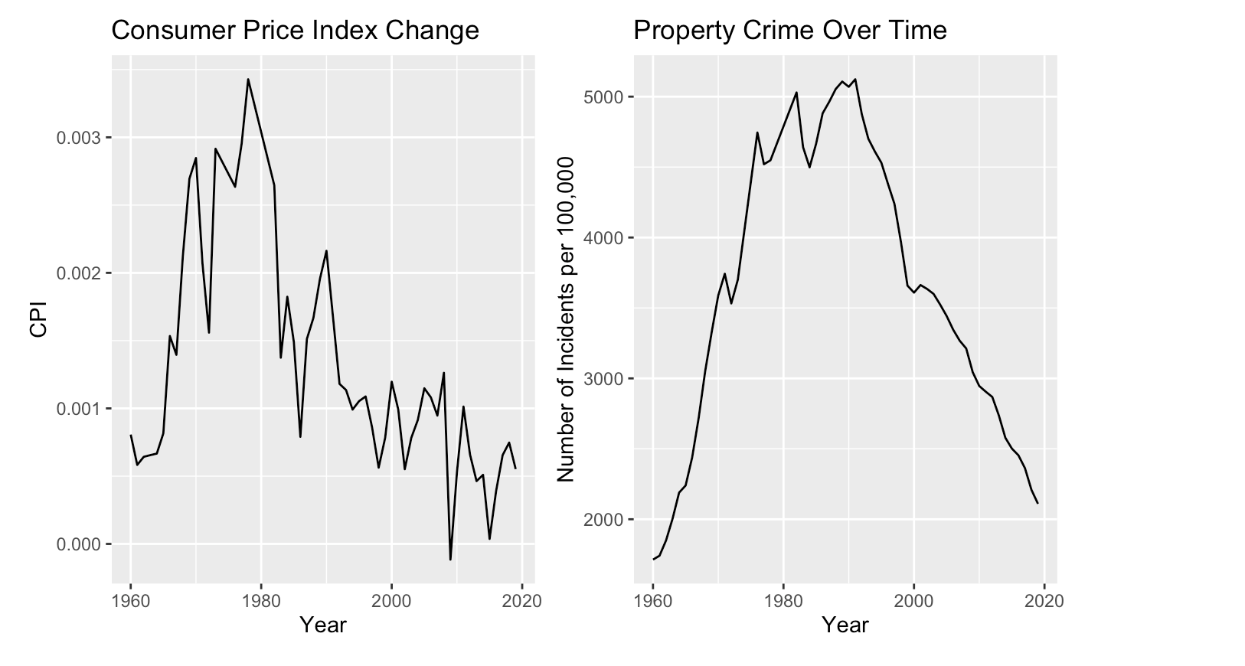
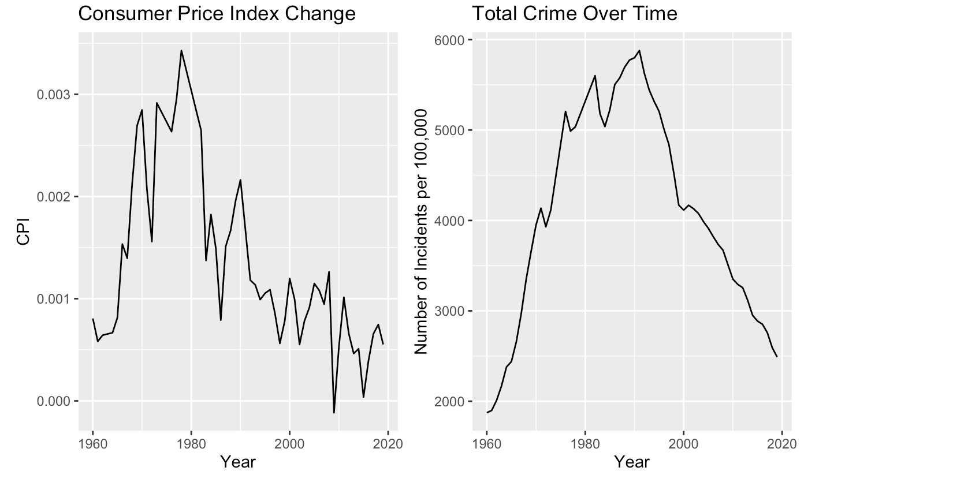
Per 100,000 Comparisons
Notes:
After adjusting the crime statistics per 100,000 pop we can see that the behavior stays the same, as only the scale was adjusted, but the general behavior stays the same.
Therefore, we can use the adjusted data for our following tests and methods.

Slide 7
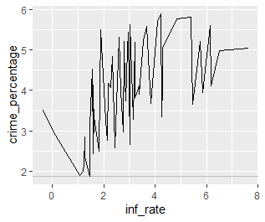
Inflation rate vs Crime percentage
Notes:
As we can see in this plot, there is a relation between the percentage of crime, which is the percentage of the total number of crimes per the entire population, and the inflation rate.
However, this relation is not completely clear, and we will require further tests and analysis to determine what, if any , the relation is.

Slide 8
Correlation Tests
Notes:
The correlation tests are done to evaluate the association between two or more variables or samples.
In this case, we performed this test for the inflation rate against every crime type, to see how they were related.
R uses the Pearson test as a default, which is the one we used.
In the Pearson test, there are 3 possible results:
Values between -1 and 0, 0, and values between 0 and 1.
Values between -1 and 0 mean that the relation is negative: The more one value increases, the more the other decreases.
0 means that there is no correlation at all.
Values between 1 and 0 means that the relation is positive: the more one value increases, so does the other.

Slide 9
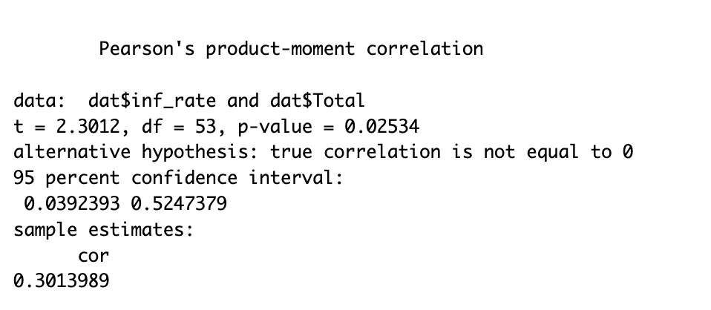
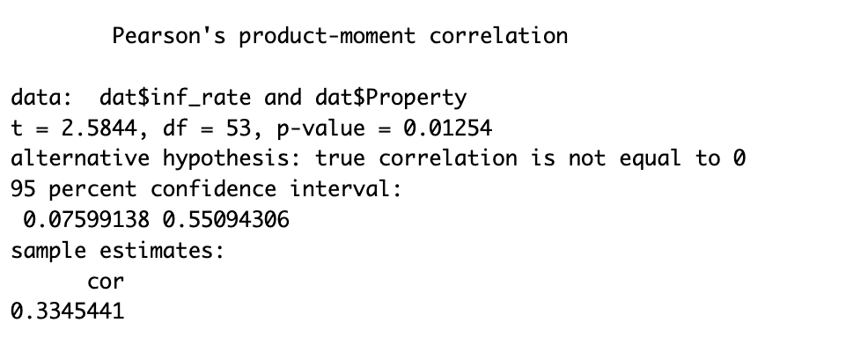
Correlation Tests on Totals
Notes:
As we can see, for some of the crimes, the correlation is lower than 0.5, which means that although there is a degree of relation, it is too low.

Slide 10
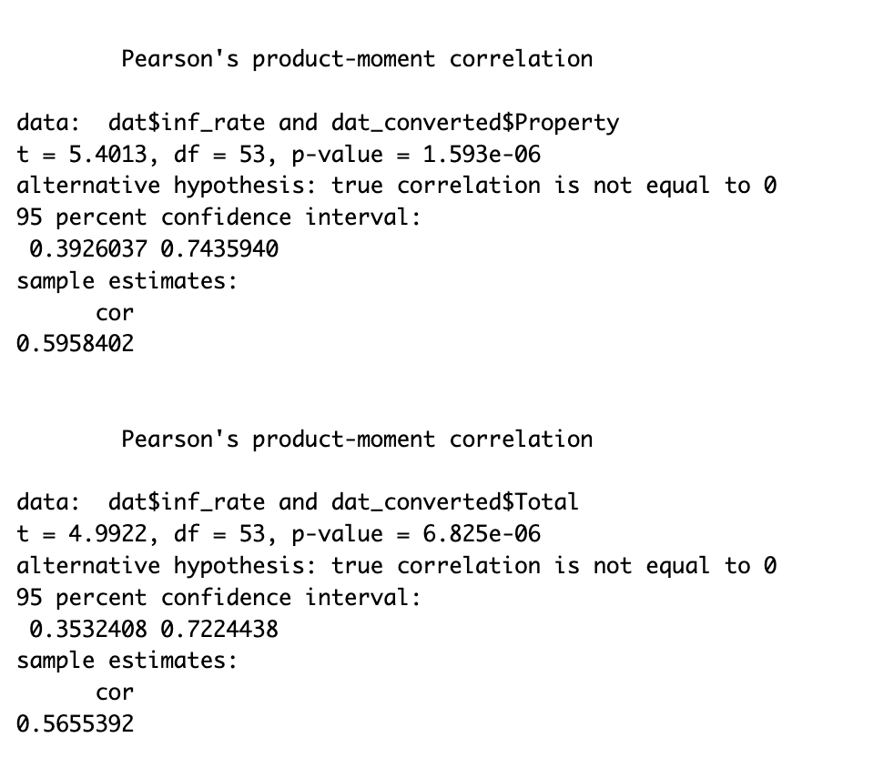
Correlation Tests on Crime Data Per 100,000
Notes:
However, for others, once we used the crimes per 100,000 dataset, we saw that some had a strong correlation.

Slide 11
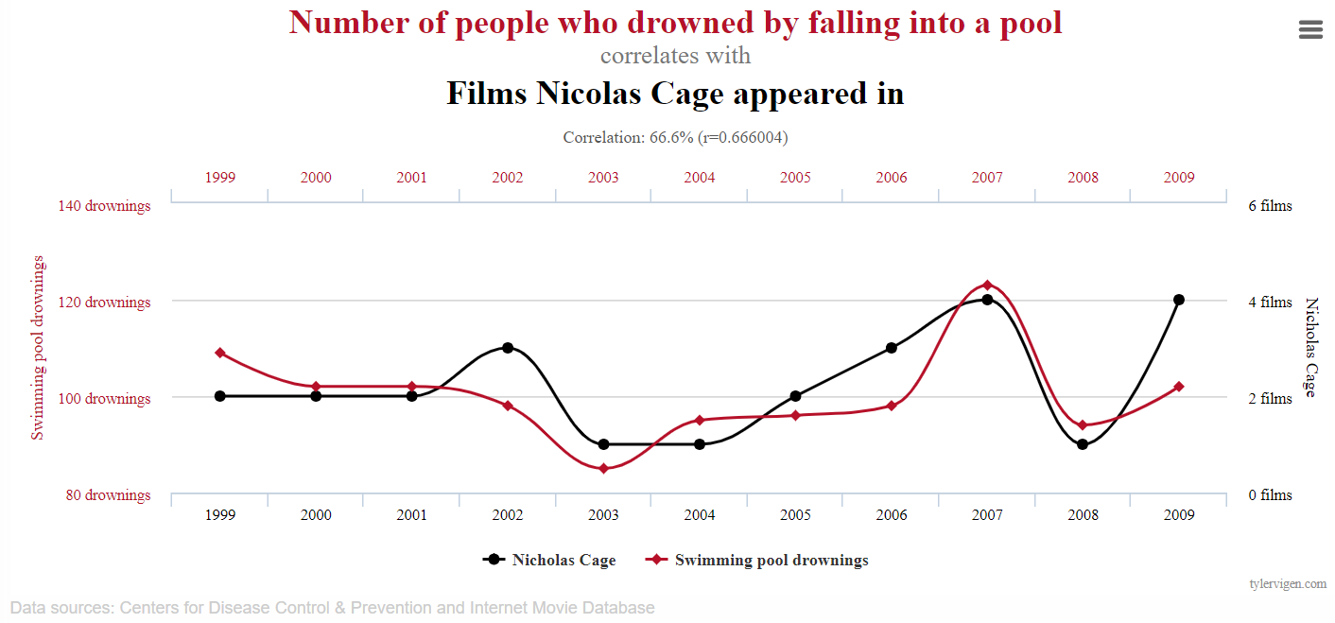
Granger Model
Used to determine whether a time series can forecast another one
Although called the Granger causality test, it is more appropriate to say it tests if one forecasts the other
Lag?
Notes:
The Granger causality test is used to determine whether a time series or dataset can forecast another one.
Although called the causality test, it is better to say that it tests only whether a dataset can be used to forecast or predict another one, as correlation does not necessarily mean causality.
A funny example of this is the correlation between the number of people drowned by falling into a pool vs the number of films in which Nicholas Cage appears in. It is almost a direct correlation, so although Nicholas Cage taking part in a movie could be used to predict an increase in drownings, it probably is not the cause.
(taken from https://www.tylervigen.com/spurious-correlations)

Slide 12
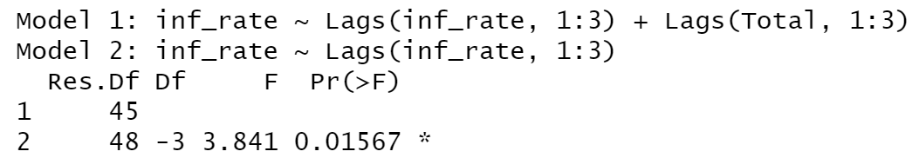
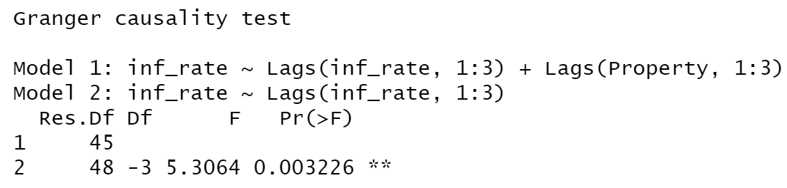
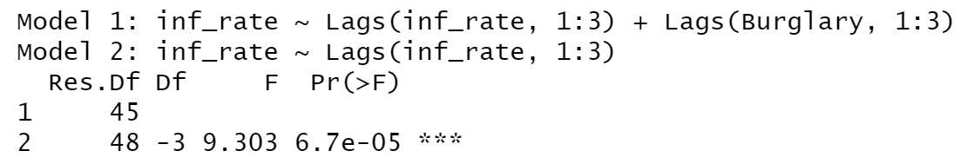
Granger Results
The tests were performed on 3 monetary related statistics: total crime, property related crimes, and burglary.
From those 3, we could reject the null hypothesis for all 3, which indicates that knowing the inflation rate can be used to forecast the crime rates.
Notes:
As the inflation is a monetary metric, we focused on money-related crimes, such as property crimes, burglary, and the general statistics for crime.
The null hypothesis of the Granger test states that dataset 1 does not help us to forecast dataset 2. In our case, the null hypothesis states that the inflation rates do not help us forecast the crime rates.
For our 3 tests, the p values were lower than 0.05, so we can reject the null hypothesis, and conclude that the inflation rates can be used to predict the crime rates.

Slide 13
Conclusions
There is a moderate correlation between these two variables when crime is converted to per 100,000.
All correlation tests generated p-values under .05.

Slide 14
Models
VAR and Prophet

Slide 15
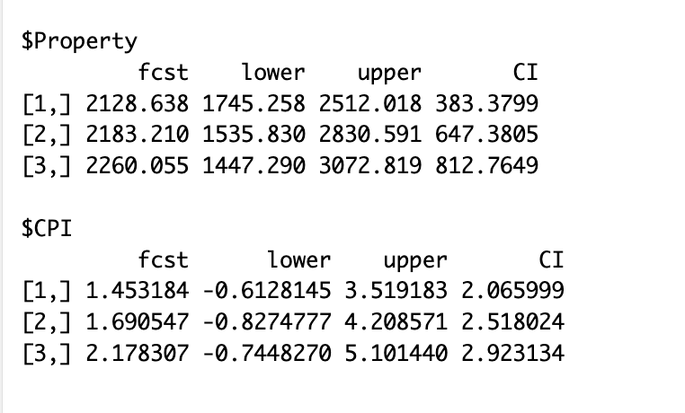
VAR
I chose a Vector Autoregression
Choosing a model was difficult
My research indicates this was useful for multivariate time series calculations.
Results seemed to make sense.

Slide 16
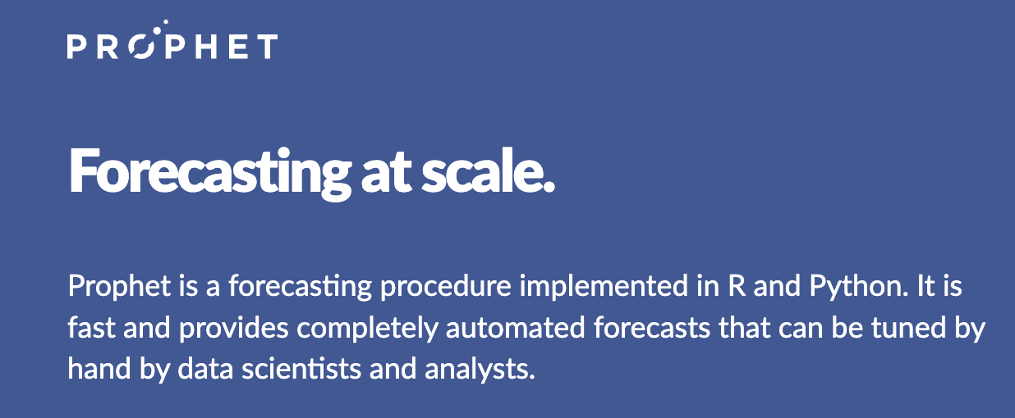
Facebook Prophet
Choosing a model can be difficult.
That is why Facebook created its own model software.
Specifically designed for seasonal data.
Specifically designed for social media interactions.
Taylor SJ, Letham B. 2017. Forecasting at scale. PeerJ Preprints 5:e3190v2 https://doi.org/10.7287/peerj.preprints.3190v2
Notes:
The downside is likely that you have less control over the models. However, Prophet does allow experienced users to tailor the forecast for their needs. It can adjust for seasonal data, holidays, etc. It seems to be popular sofrware even for applications outside of social media.

Slide 17
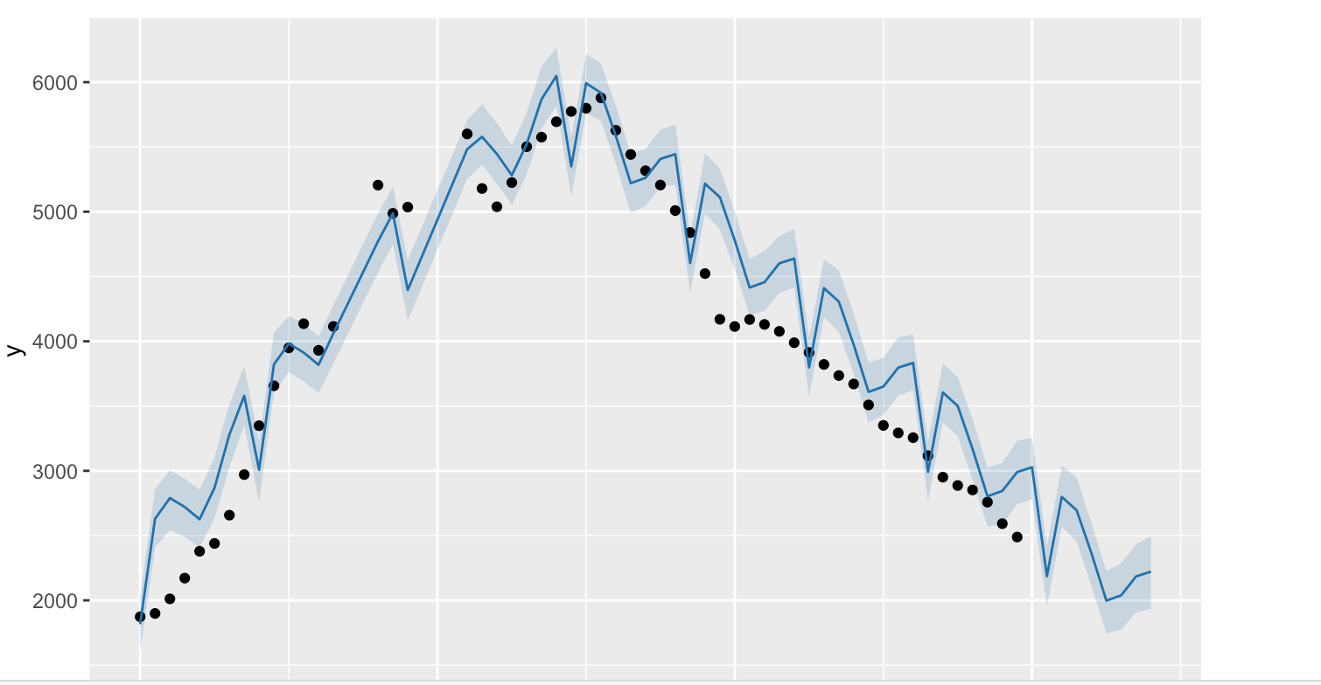
Facebook Prophet Prediction
Enter future inflation values as a vector and Prophet will predict.
Forecast seemed to be realistic.
I did have overfitting issues though.
Notes:
I was impressed with the visualizations Prophet created. The model was fairly close to observed data and the predictions made sense.

Slide 18
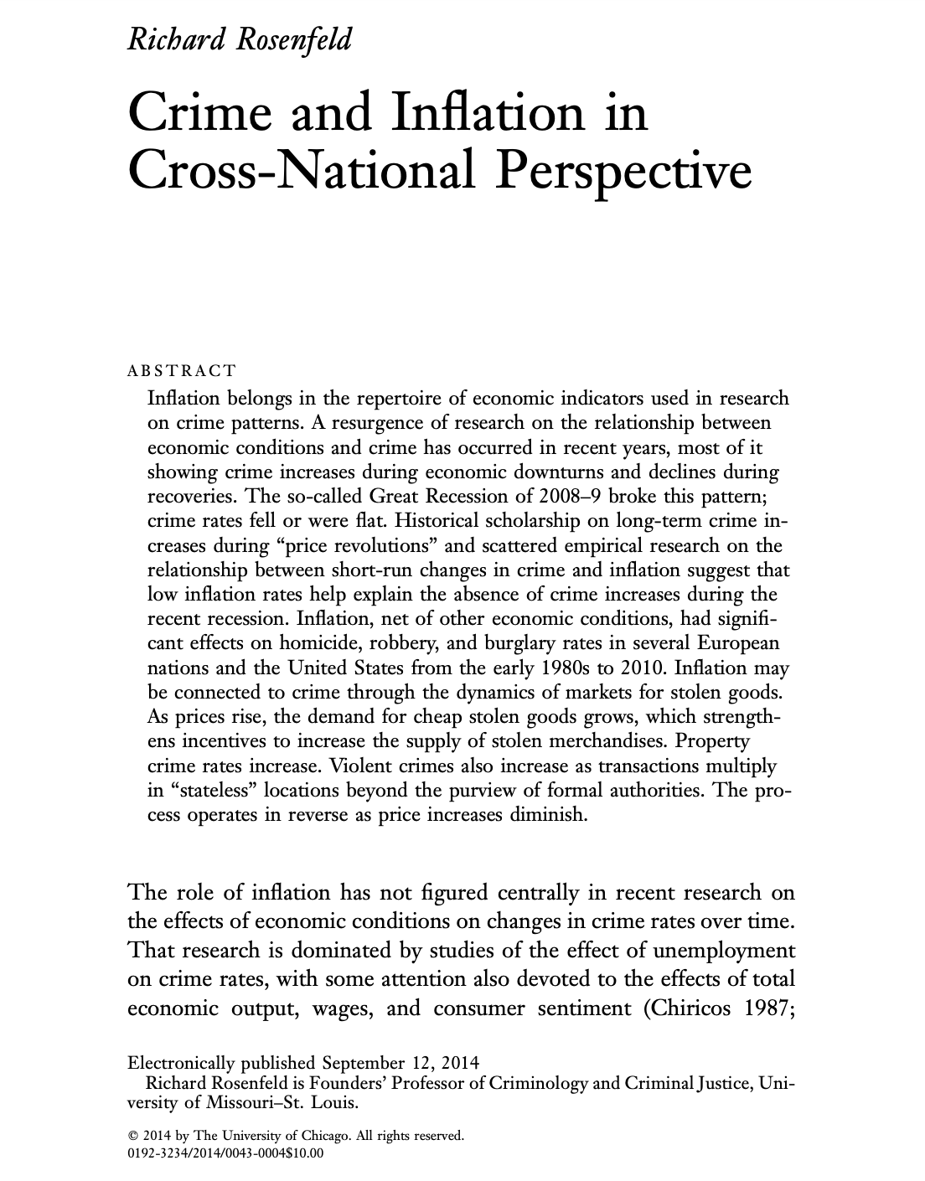
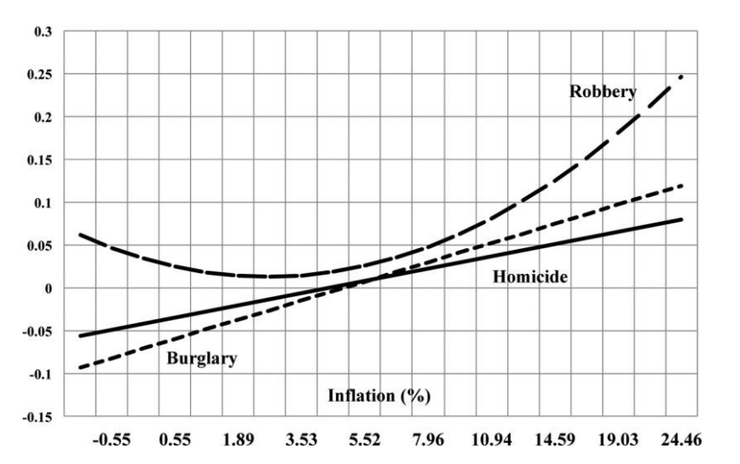
How could we improve?
Notes:
Not much research has been done in this area but most of what has been done was performed by Richard Rosenfeld. His analysis produced a curvilinear relationship between inflation and crime.

